Slide 1
20190422
Machine Learning를 이용한 1D DBR 설계
Deep Neural Network
Lee Jong Geon

Slide 2
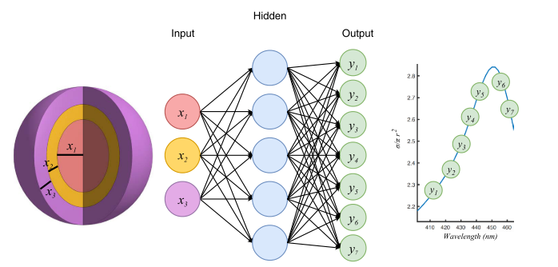
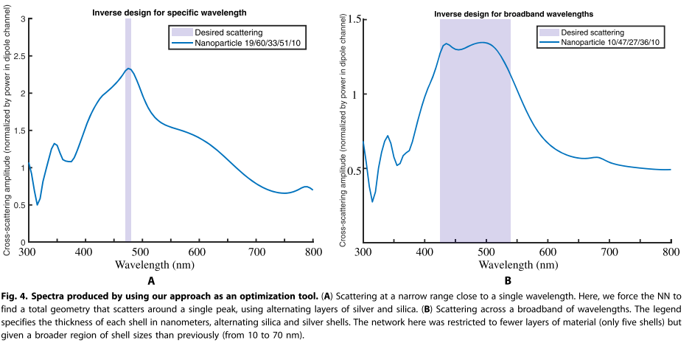
Deep Neural Network (DNN)
2018-Science Advances-4-Nanophotonic particle simulation and inverse design using artificial neural networks (John Peurifoy, Yichen Shen, Li Jing, Yi Yang, Fidel Cano-Renteria, Brendan G. DeLacy, John D. Joannopoulos, Max Tegmark, Marin Soljačić)
Input: Shell의 개수가 정해졌을 때 각각의 두께
Alternating shells of TiO₂ and silica
50,000 training data, 250 neurons per layer, 4 layers
99% accuracy
=> Layer의 개수를 정해주고 각각의 thickness에 따른 spectrum이 출력되도록 학습

Slide 3
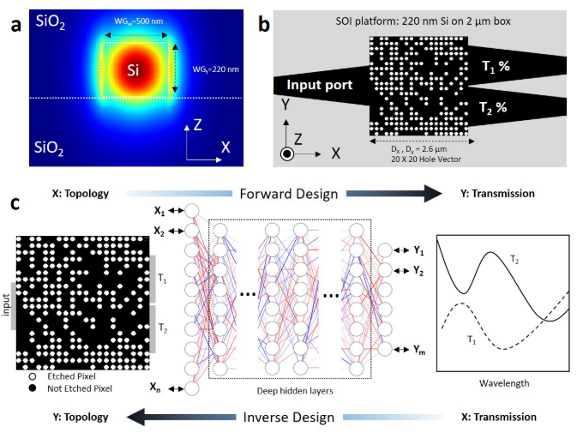
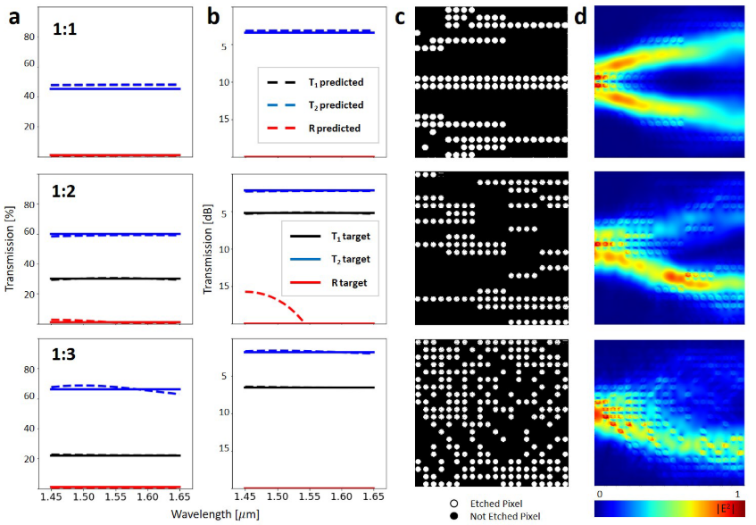
Convolutional Neural Network (CNN)
2019-Science Reports-9-Deep Neural Network Inverse Design of Integrated Photonic Power Splitters
(Mohammad H. Tahersima, Keisuke Kojima, Toshiaki Koike-Akino, Devesh Jha, Bingnan Wang, Chungwei Lin & Kieran Parsons)
20x20 hole
10,000 training data, 100 neurons per layer, 8 layers
99% accuracy
=> Silicon을 pixel로 나누고, state에 따라 spectrum이 출력되도록 학습

Slide 4
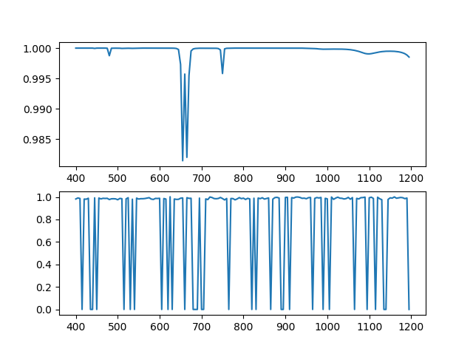
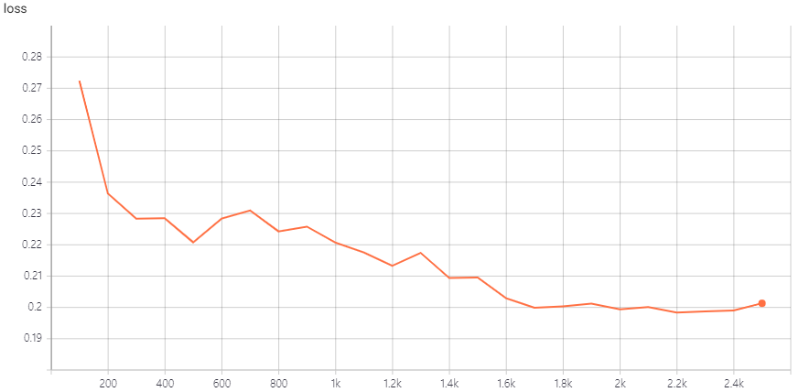
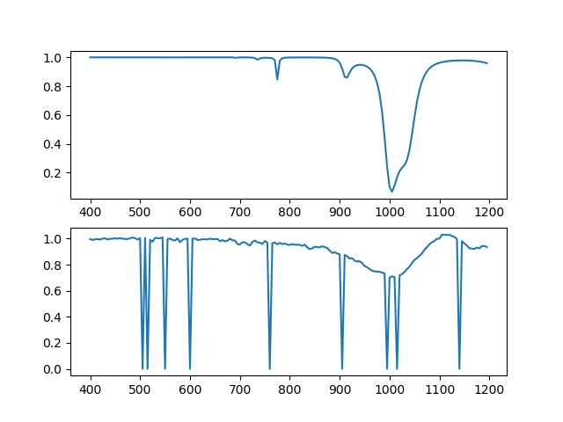
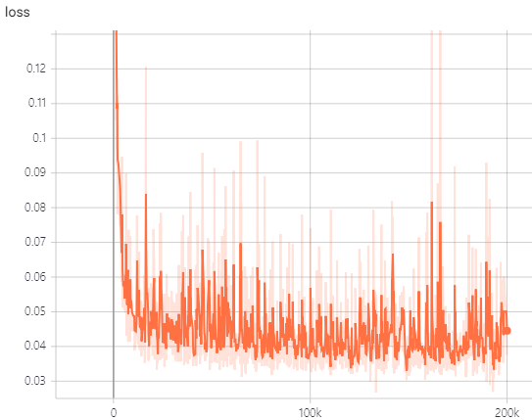
Deep Neural Network (DNN)
Calculation
Simulation
Epoch
100,000 training data, 800 neurons per layer, 4 layers
Convolutional Neural Network (CNN)
Calculation
Simulation
200,000 training data, 800 neurons per layer, 3 layers
Number of Train Data

Slide 5
This Week
Model Optimization
Hyper-parameter: number of neurons, layers and learning rate
Technique: dropout, batch normalization
Goal: loss < 0.01
Inverse Design

Slide 6
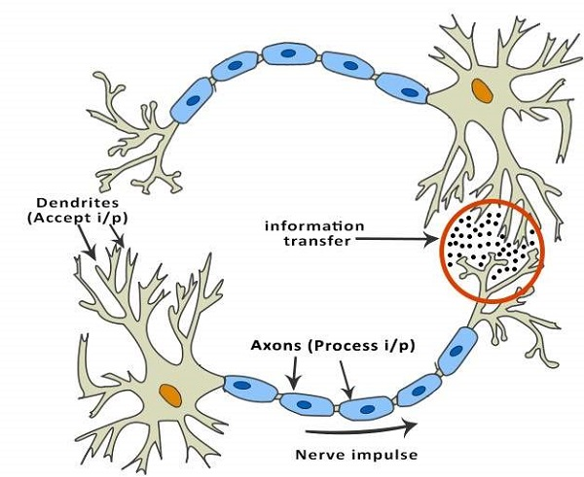
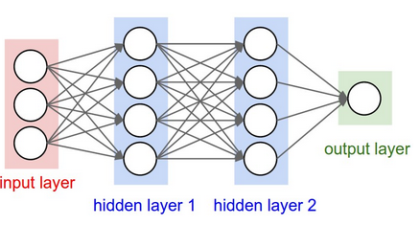
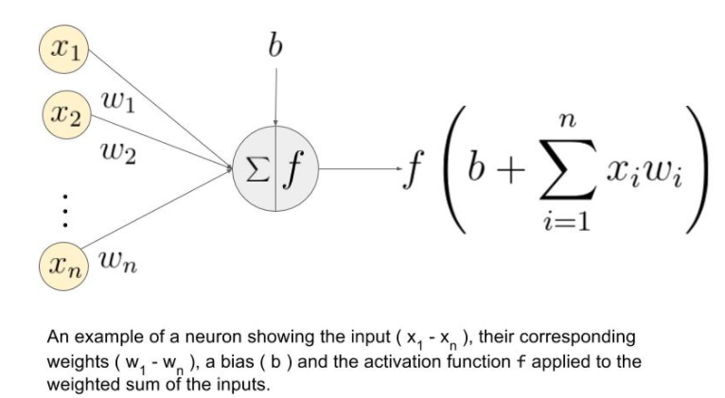
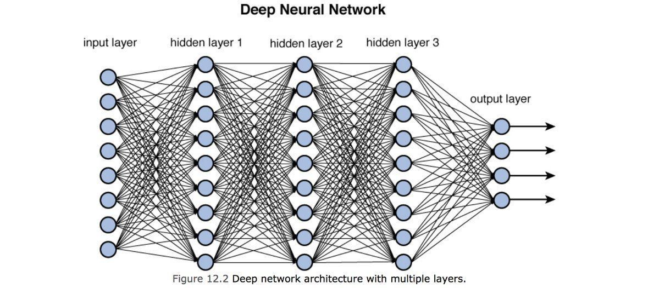
Deep Neural Network (DNN)
Neurons
Neural Network
“Deep” Neural Network
Many(Deep) Layers

Slide 7
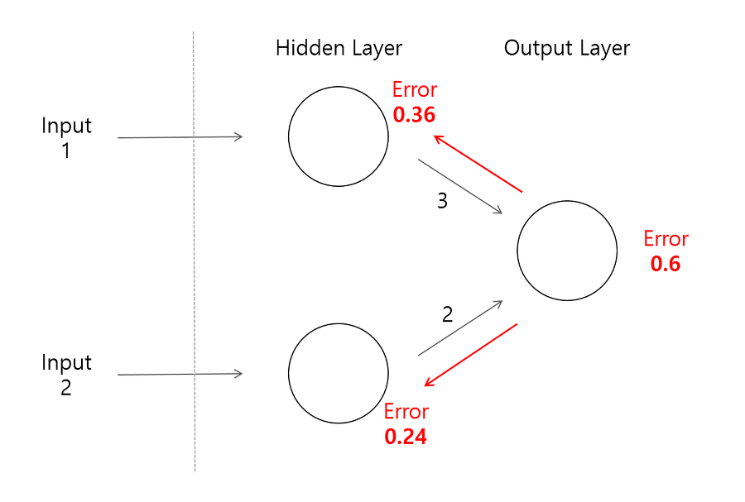
Deep Neural Network (DNN)
Train Data Set(Input Data + Output Data)
“Calculated”
Output
Data
Input
from train data
Adjust weight & bias of layers
Minimize MSE(“Calculated” Output Data, Output from train data)
무조건 layer 개수를 늘릴 수 없는 이유
Error backpropagation이 어려워져 학습 속도 저하 및 에러 발생

Slide 8
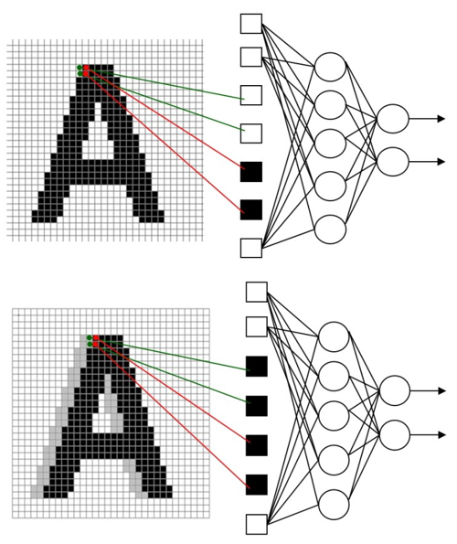
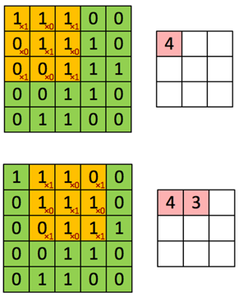
Convolutional Neural Network (CNN)
Input의 raw data를 바로 사용할 경우
많은 학습 데이터 필요
이에 따라 증가하는 학습 시간
=> 특정 범위의 data를 convolution하여 사용

Slide 9



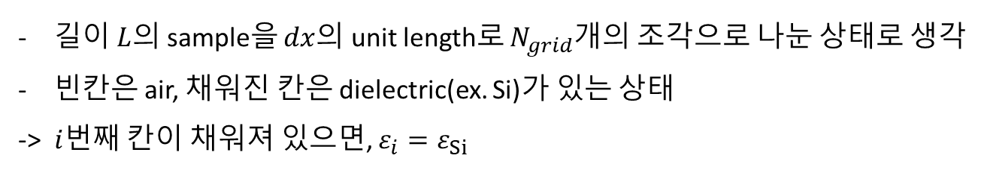
1D DBR model
$$L=N_{grid}∗dx$$
$$dx$$
$$i$$
…
길이 $L$의 sample을 $dx$의 unit length로 $N_{grid}$개의 조각으로 나눈 상태로 생각
빈칸은 air, 채워진 칸은 dielectric(ex. Si)가 있는 상태
-> $i$번째 칸이 채워져 있으면, $ε_{i}=ε_{Si}$

Slide 10
Artificial Intelligence
Machine Learning
Supervised
Learning
Unsupervised Learning
Reinforcement
Learning
Classification
Clustering, recommendation
Reward maximization

